Slide 1

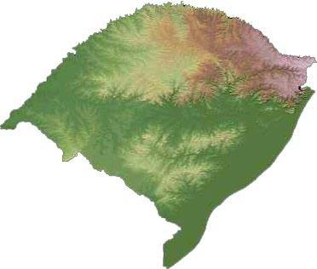
GLOBAL URBAN DEVELOPMENT
Planning for Regional Development:
Metropolitan Economic Strategy,
Sustainable Innovation, and
Inclusive Prosperity for
Rio Grande do Sul
POLO NAVAL E OFFSHORE APL
FURG, Rio Grande, November 5, 2014
Dr. Marc A. Weiss
Chairman and CEO
Global Urban Development (GUD)

Slide 2
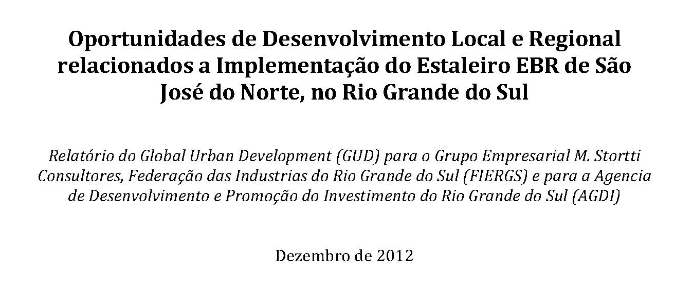
GLOBAL URBAN DEVELOPMENT

Slide 3
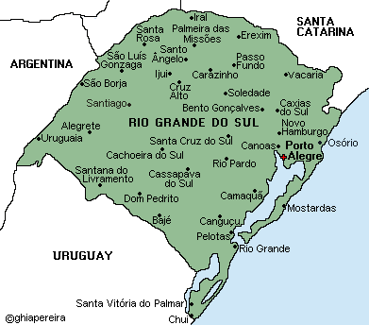
GLOBAL URBAN DEVELOPMENT
Rio Grande do Sul:
Most Sustainable and Innovative Place in Latin America by 2030

Slide 4
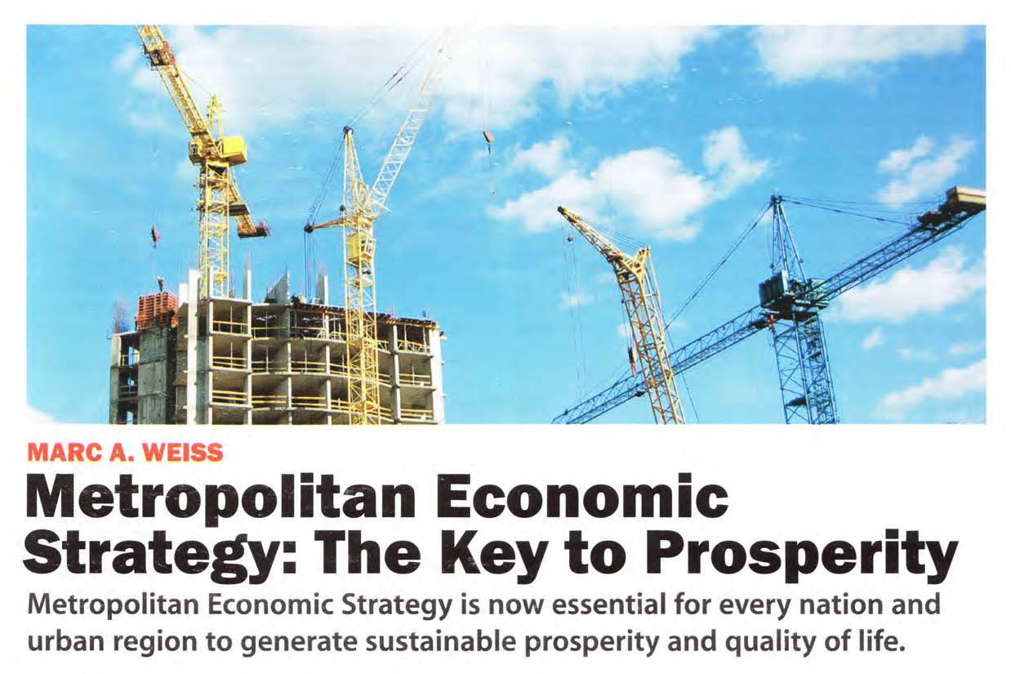
GLOBAL URBAN DEVELOPMENT

Slide 5
METROPOLITAN ECONOMIC STRATEGY: ADVANCING INNOVATION AND PROSPERITY
GLOBAL URBAN DEVELOPMENT
Knowledge and Information-Based
Technology and Communications-Intensive
Urban and People-Centered
Resource Efficient and Sustainable
Globally Oriented

Slide 6
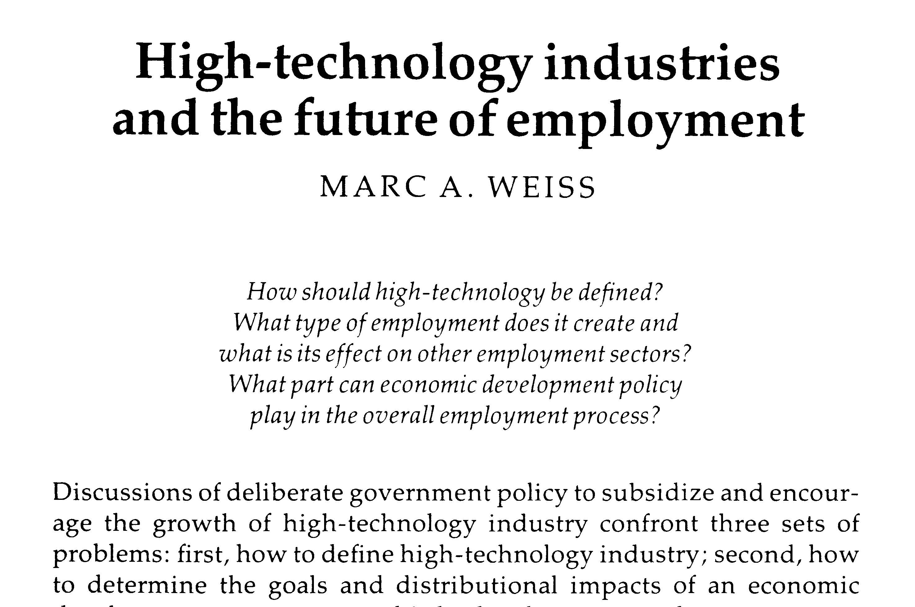
GLOBAL URBAN DEVELOPMENT
California Commission on Industrial Innovation, 1981-82

Slide 7
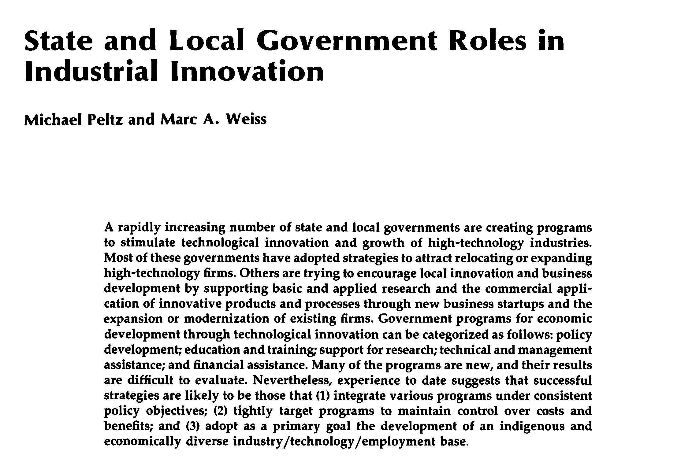
GLOBAL URBAN DEVELOPMENT

Slide 8
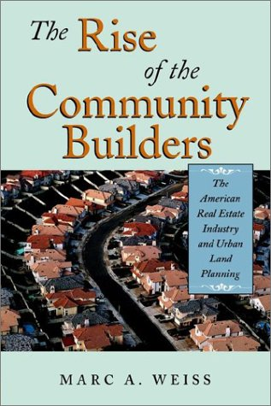
GLOBAL URBAN DEVELOPMENT

Slide 9
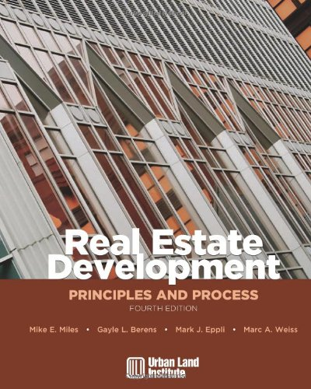
GLOBAL URBAN DEVELOPMENT

Slide 10
Sustainable Economic Development Strategy for Berkeley, California, 1979-83
GLOBAL URBAN DEVELOPMENT
10
Notes:
Global Urban Development
10

Slide 11
GLOBAL URBAN DEVELOPMENT
From the California Commission on Industrial Innovation to Sustainable Innovation and Clean Technology
11
Notes:
Global Urban Development
11

Slide 12
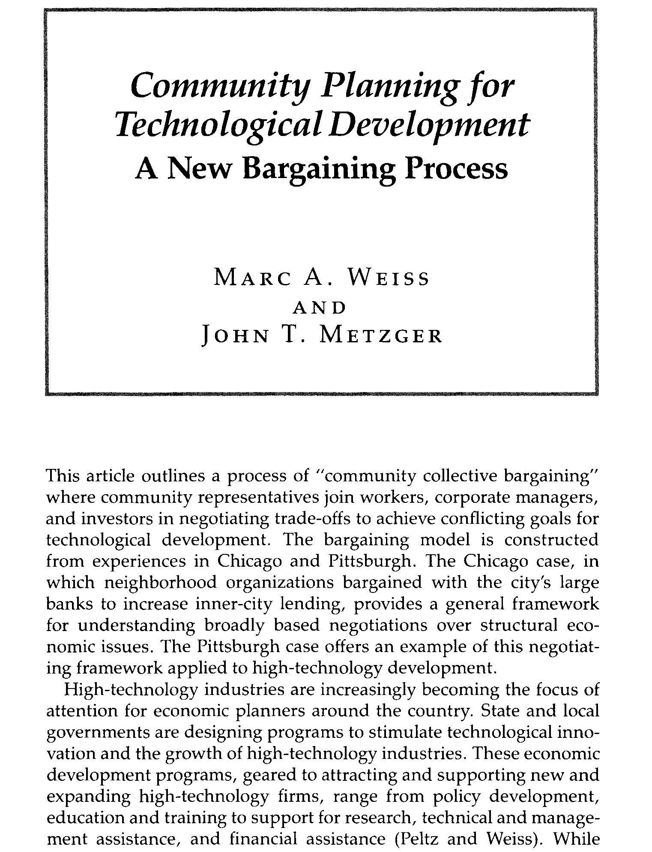
GLOBAL URBAN DEVELOPMENT

Slide 13
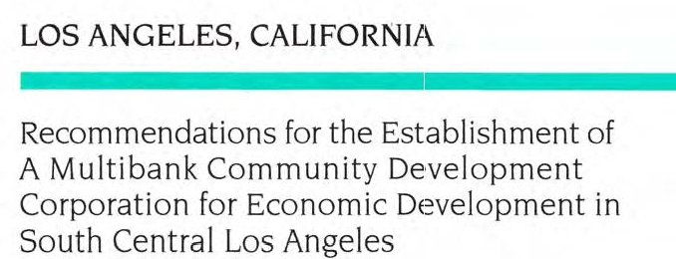
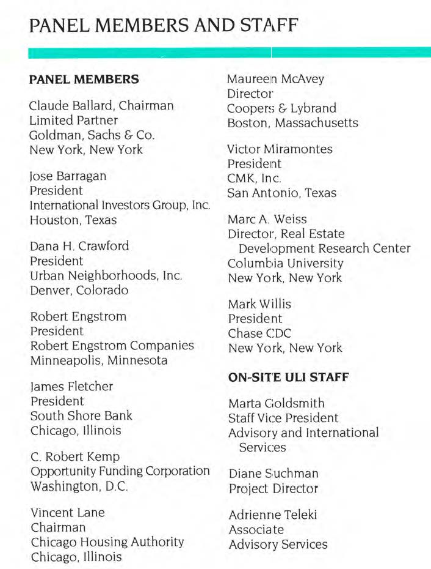
GLOBAL URBAN DEVELOPMENT

Slide 14

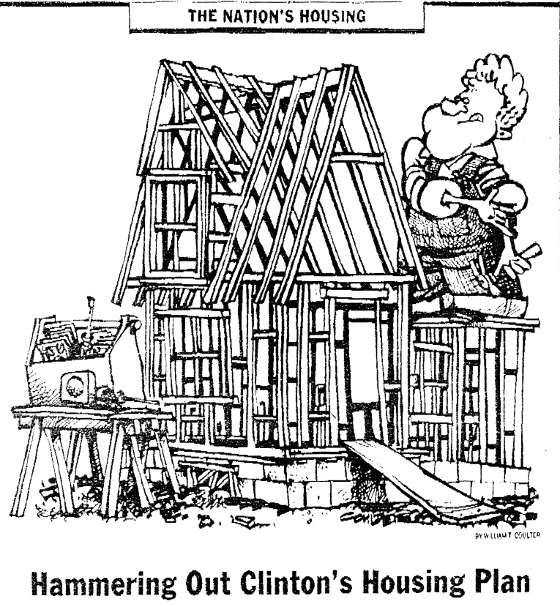
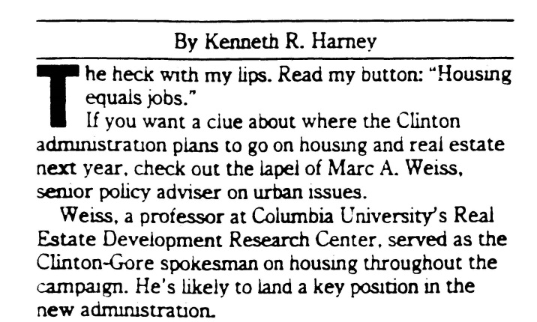
1992 Clinton Presidential Campaign
GLOBAL URBAN DEVELOPMENT

Slide 15

GLOBAL URBAN DEVELOPMENT
President’s Council on Sustainable Development

Slide 16
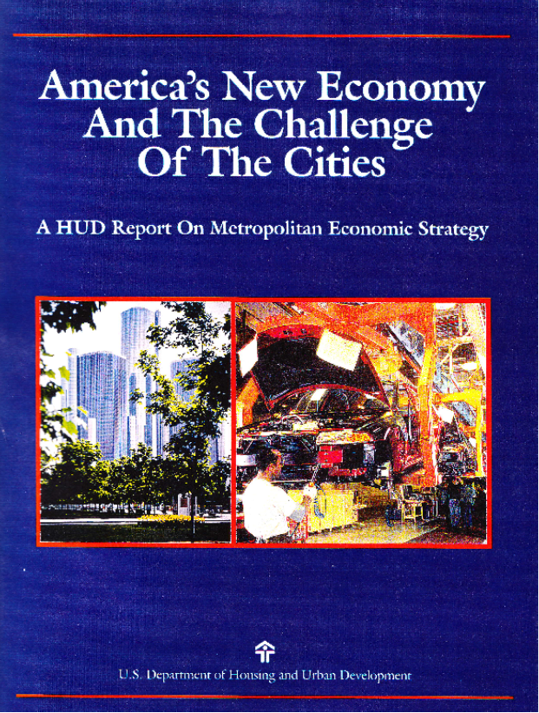
Clinton Administration Metropolitan Economic Strategy National Policy Initiative
GLOBAL URBAN DEVELOPMENT

Slide 17
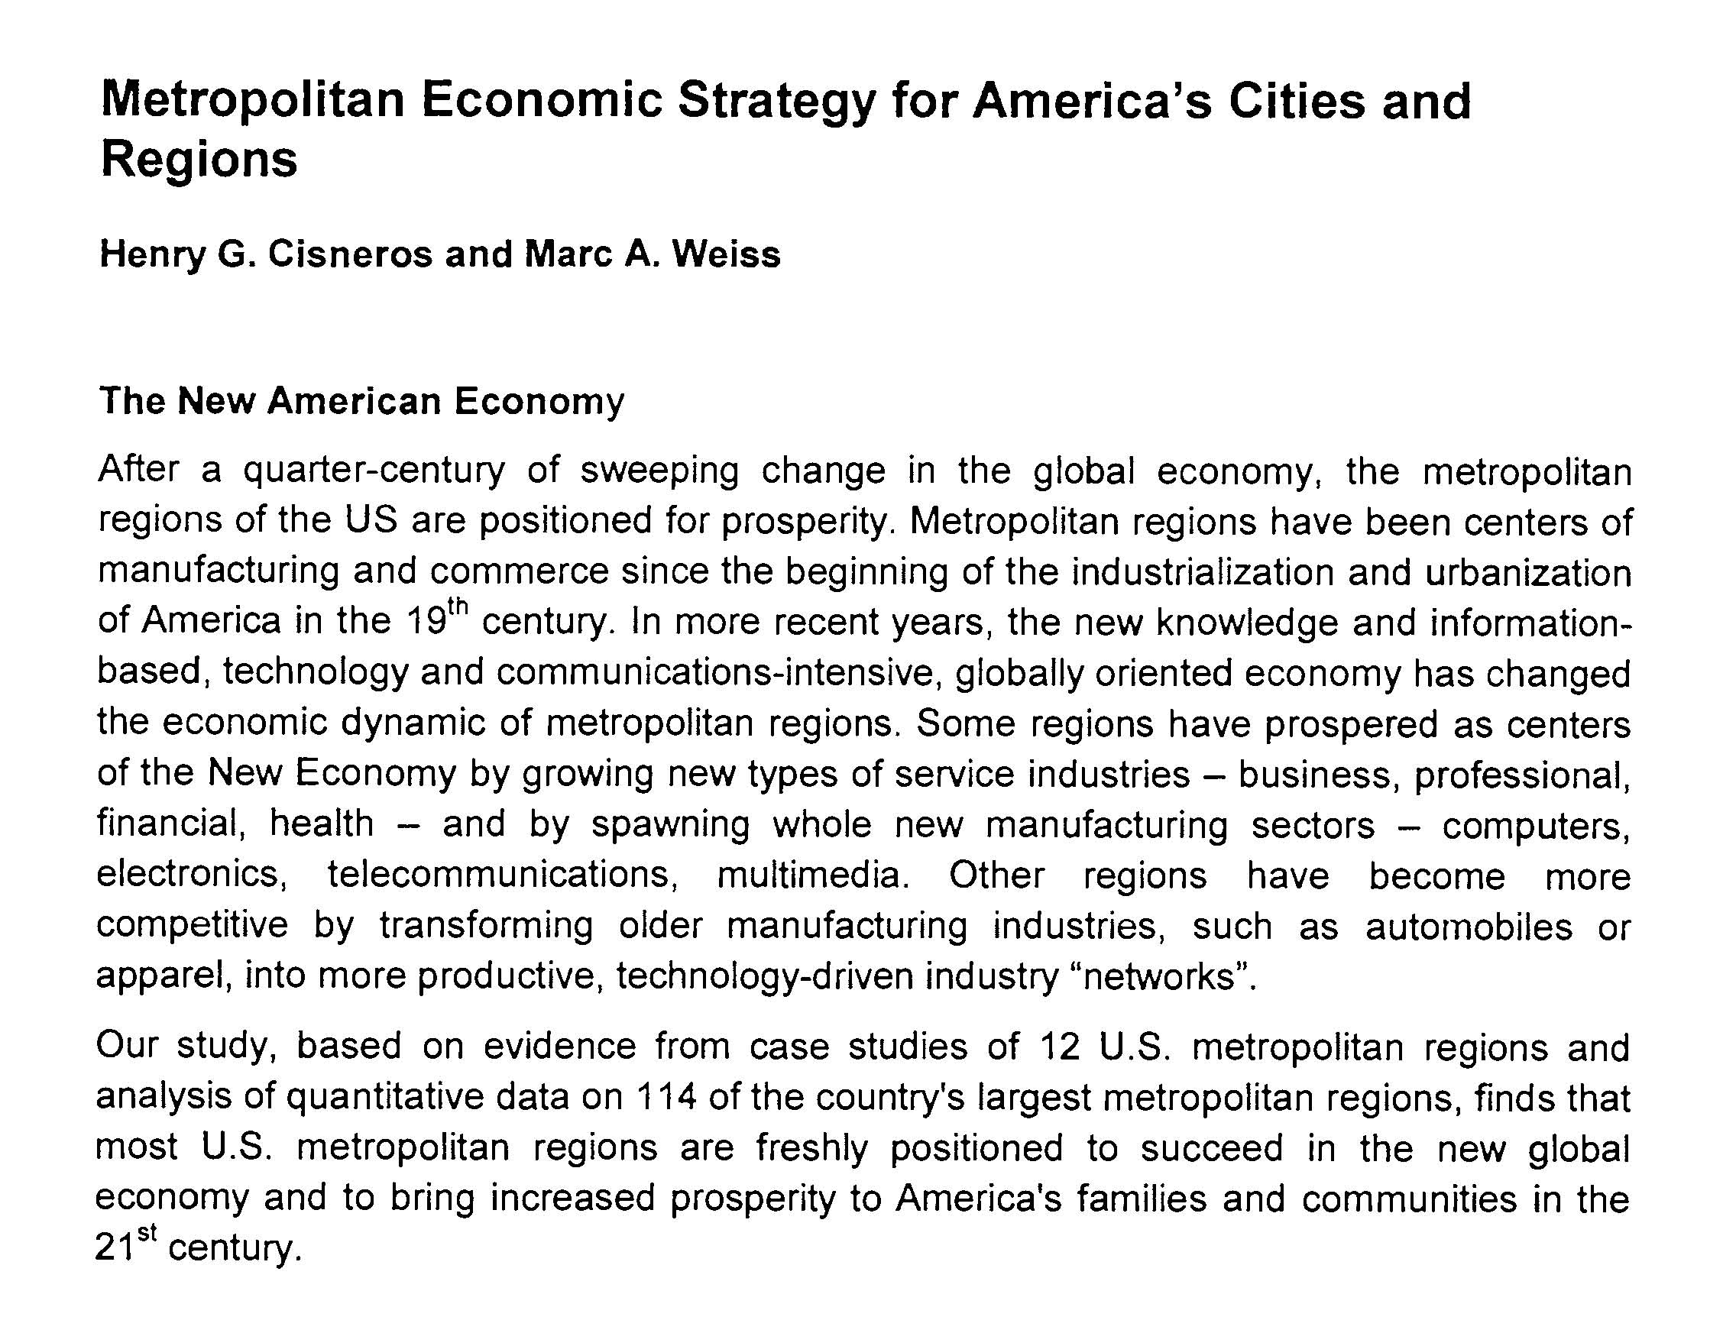
GLOBAL URBAN DEVELOPMENT

Slide 18
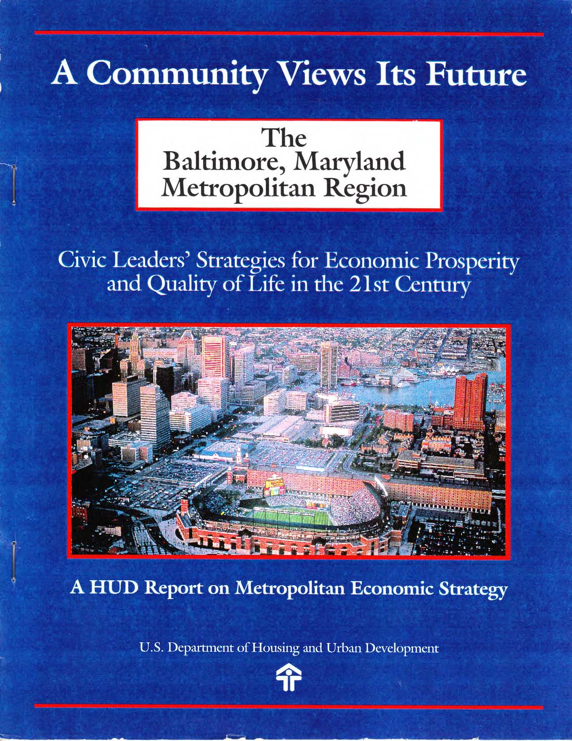
Clinton Administration Metropolitan Economic Strategy National Policy Initiative
GLOBAL URBAN DEVELOPMENT

Slide 19
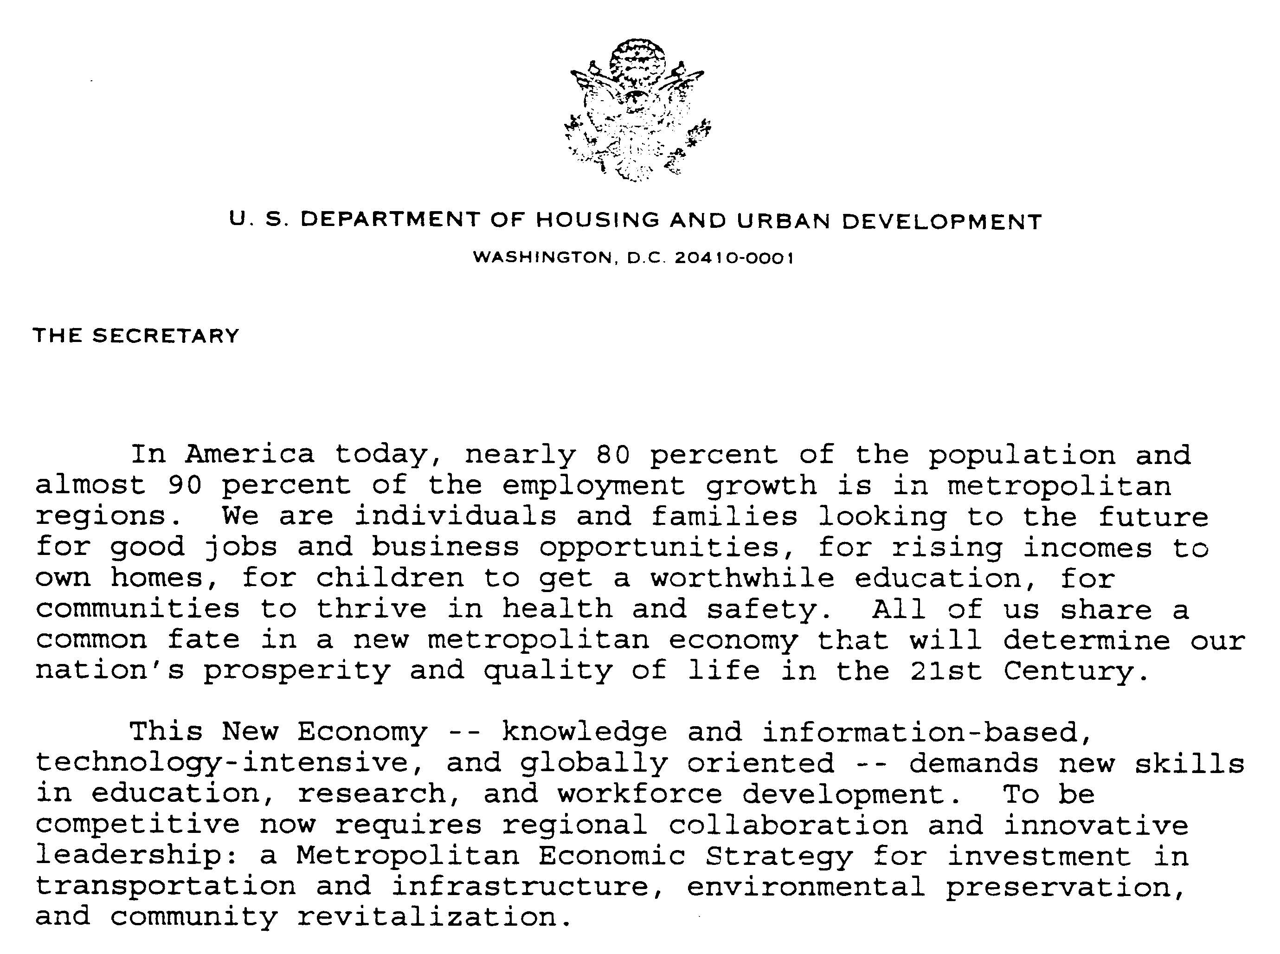

GLOBAL URBAN DEVELOPMENT

Slide 20
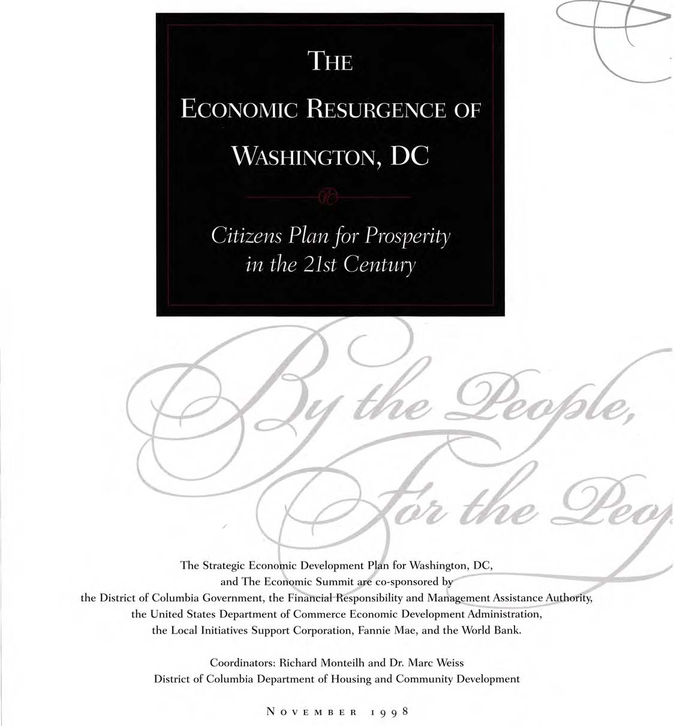
GLOBAL URBAN DEVELOPMENT

Slide 21
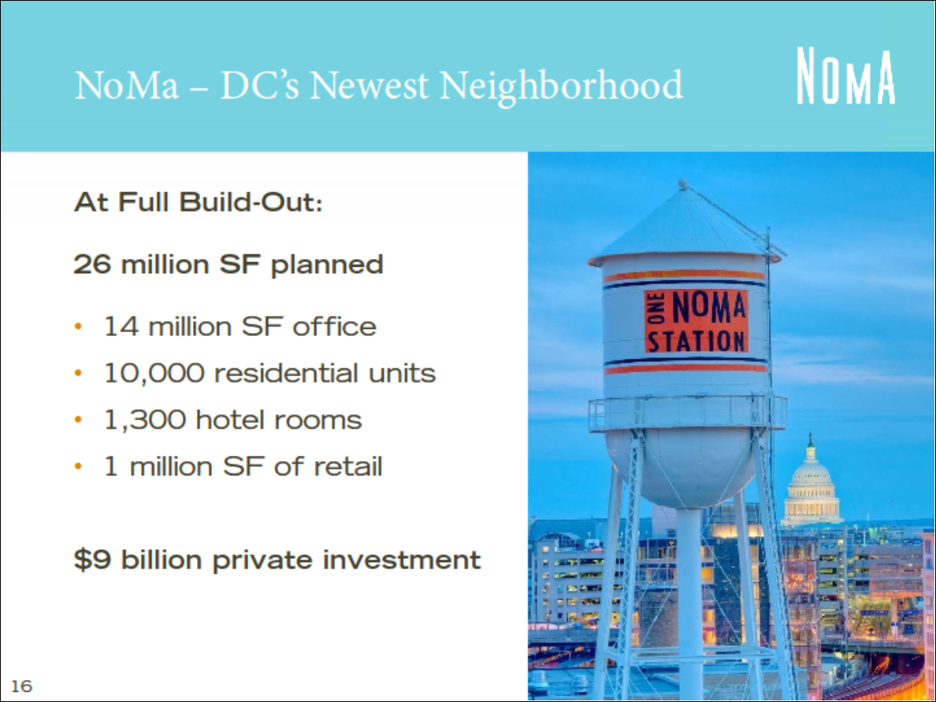
GLOBAL URBAN DEVELOPMENT

Slide 22
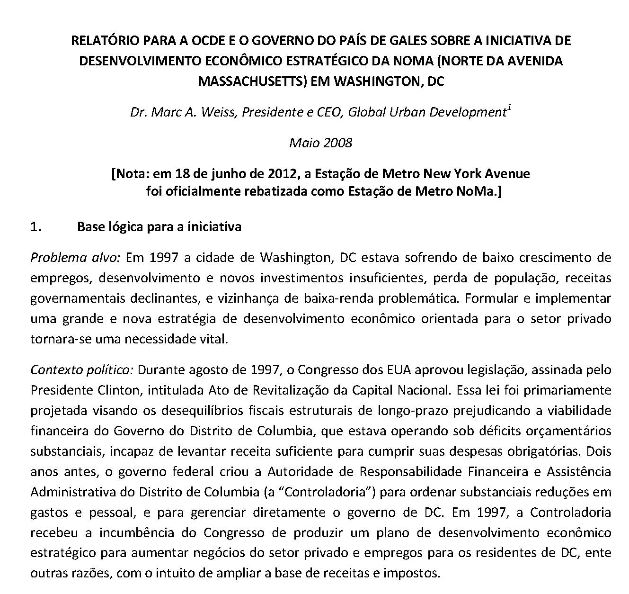
GLOBAL URBAN DEVELOPMENT

Slide 23
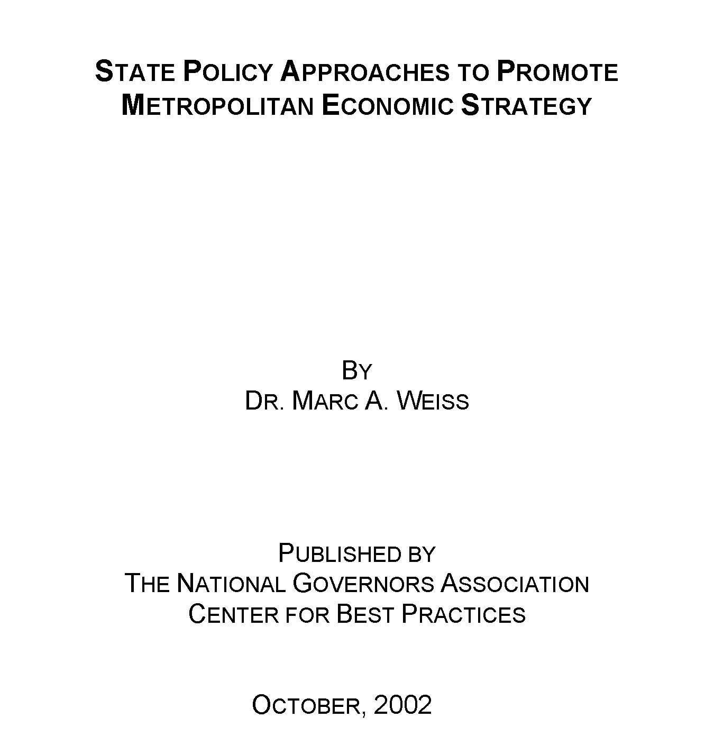
GLOBAL URBAN DEVELOPMENT

Slide 24
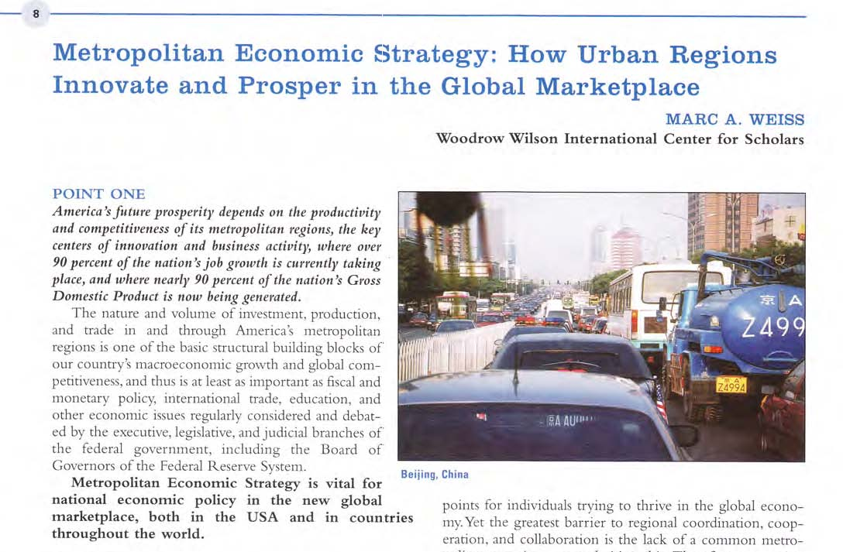
GLOBAL URBAN DEVELOPMENT

Slide 25
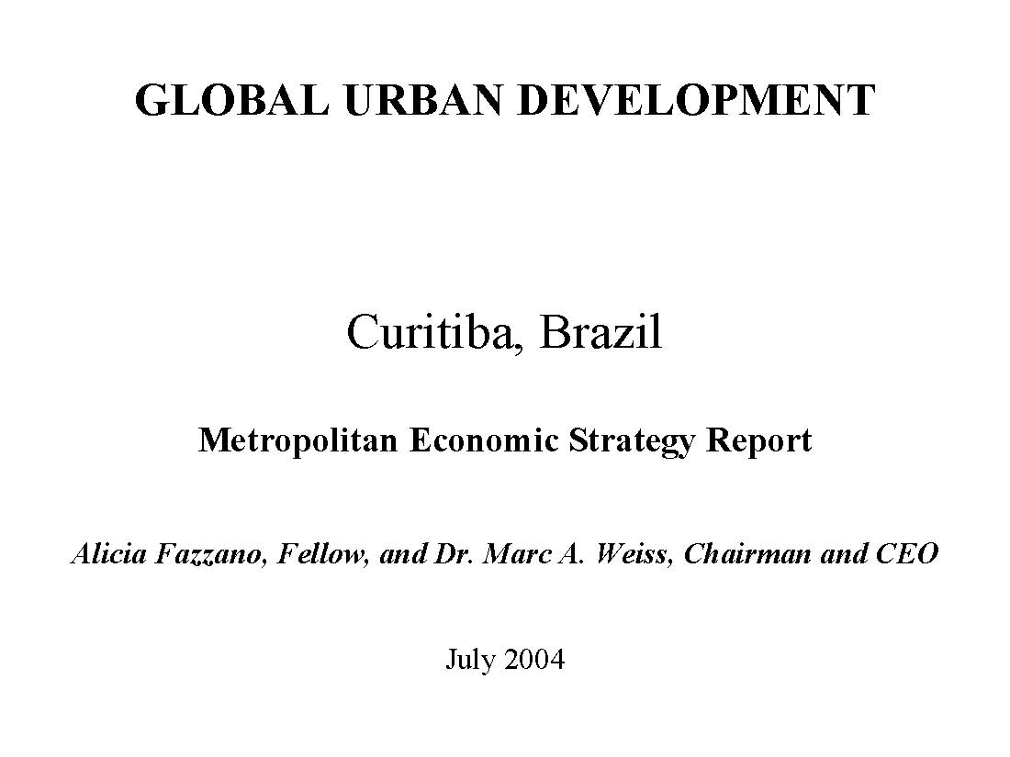
GLOBAL URBAN DEVELOPMENT

Slide 26
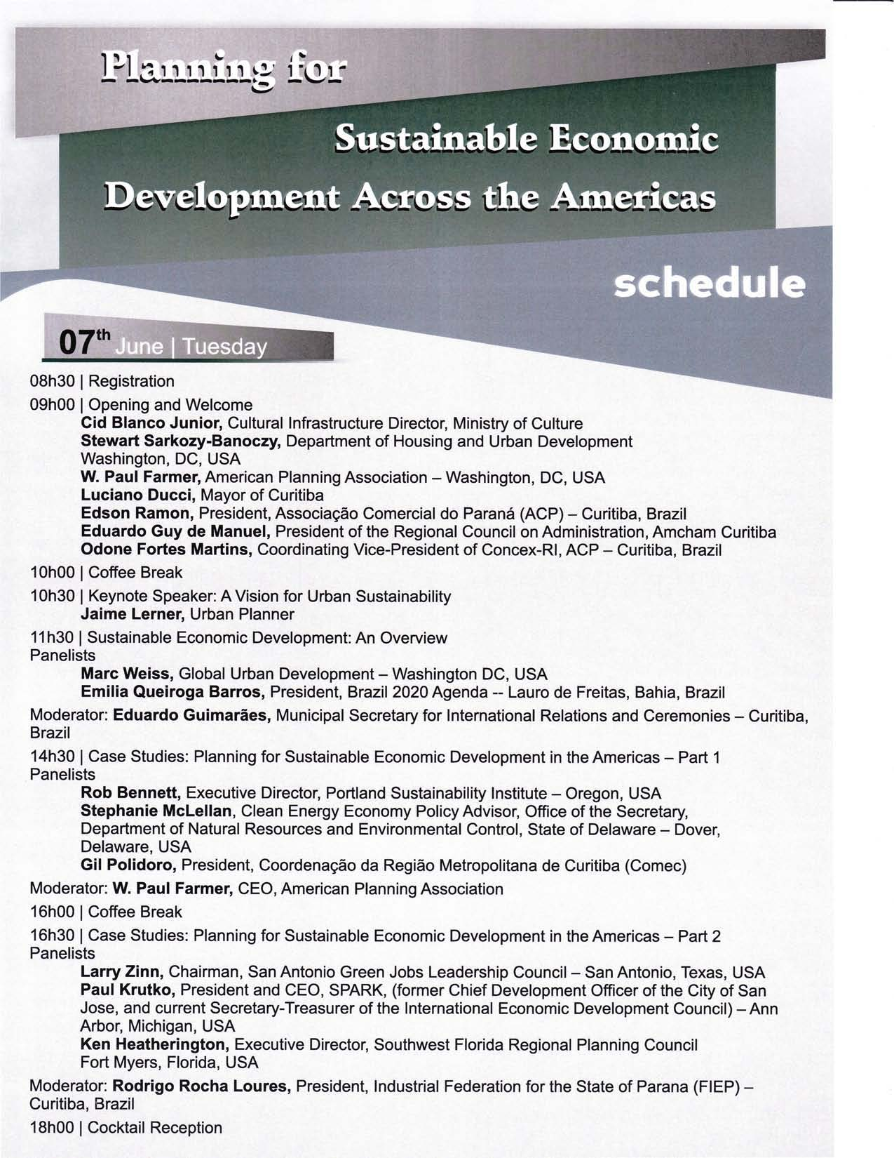
GLOBAL URBAN DEVELOPMENT
26
Notes:
Global Urban Development
26

Slide 27
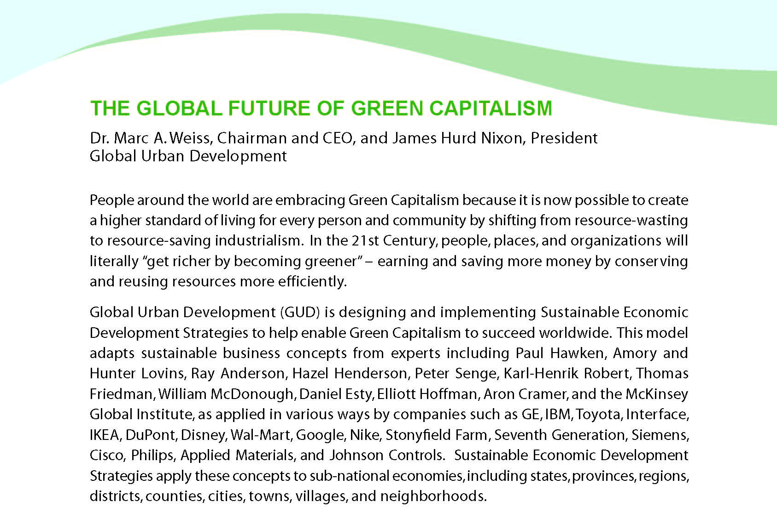
GLOBAL URBAN DEVELOPMENT
ENERGY AND CLIMATE PARTNERSHIP OF THE AMERICAS
27
Notes:
Global Urban Development
27

Slide 28
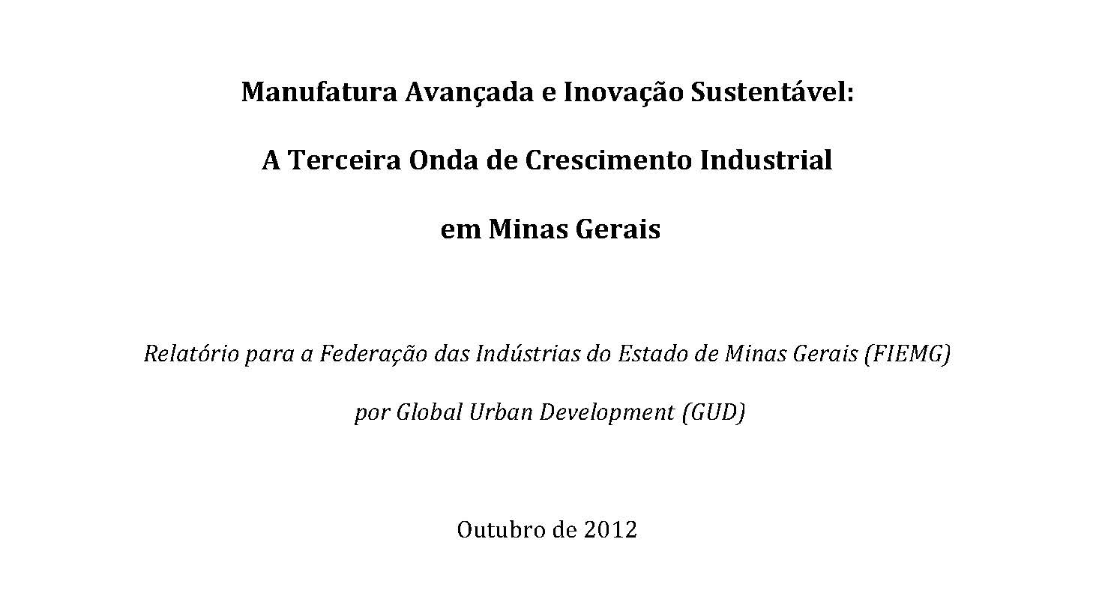
GLOBAL URBAN DEVELOPMENT

Slide 29
Why Urban Areas are More Economically Productive
GLOBAL URBAN DEVELOPMENT
They combine SPECIALIZATION and DIVERSITY:
the critical mass of skills and resources;
the necessary population density and concentration of market incomes;
the range of specialized knowledge and institutions;
the wide diversity of vitally needed facilities and services;
and the fully developed physical and human infrastructure that are prerequisites for new ideas, products and production methods, technological and organizational innovations, and dynamic economic growth and investment.

Slide 30
GLOBAL URBAN DEVELOPMENT
Investing in Fundamental Assets and Building Dynamic Industry Networks
A good economic strategy consists of two key elements:
building from strength — investing in the fundamental assets and activities that make people more productive and places more valuable;
generating dynamism — promoting modern, globally competitive industry networks that accelerate the pace of innovation and growth.

Slide 31
PEOPLE are the most vital economic asset in the world
GLOBAL URBAN DEVELOPMENT
INVESTING IN FUNDAMENTAL ECONOMIC ASSETS:
Transportation
Infrastructure
Education
Workforce Development
Research
Technology
Markets
Capital
Health
Safety
Environment and Amenities
Culture
Quality of Life

Slide 32
THE VALUE OF INCLUSIVE ECONOMIC DEVELOPMENT
GLOBAL URBAN DEVELOPMENT
Cape Town, South Africa: “Our Golden Thread”
“It is not a question of choosing global competitiveness or the reduction of poverty — Cape Town will achieve both or neither. Reducing poverty will strengthen global competitiveness, and global competitiveness will permit reduction of poverty through economic growth and job creation.”

Slide 33
GLOBAL URBAN DEVELOPMENT
1998 WASHINGTON, DC ECONOMIC PLAN
3-PART STRATEGIC FRAMEWORK
STRATEGIC INDUSTRIES
Industry Networks
Growing Businesses and Jobs across the Private Sector
STRATEGIC POPULATIONS
Workforce Development
Attracting and Retaining Residents
STRATEGIC AREAS
Downtown
Neighborhoods

Slide 34
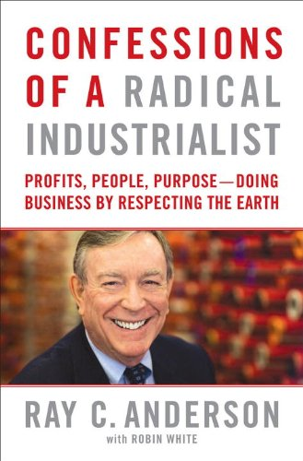
Sustainability in Business
GLOBAL URBAN DEVELOPMENT

Slide 35
The Economic Value of Quality of Life
GLOBAL URBAN DEVELOPMENT
“Over the long term, places with strong, distinctive identities are more likely to prosper than places without them. Every place must identify its strongest, most distinctive features and develop them or run the risk of being all things to all persons and nothing special to any. […] Livability is not a middle class luxury. It is an economic imperative.”
MIT Economics Professor Robert M. Solow
Winner of the 1987 Nobel Prize in Economic Sciences

Slide 36
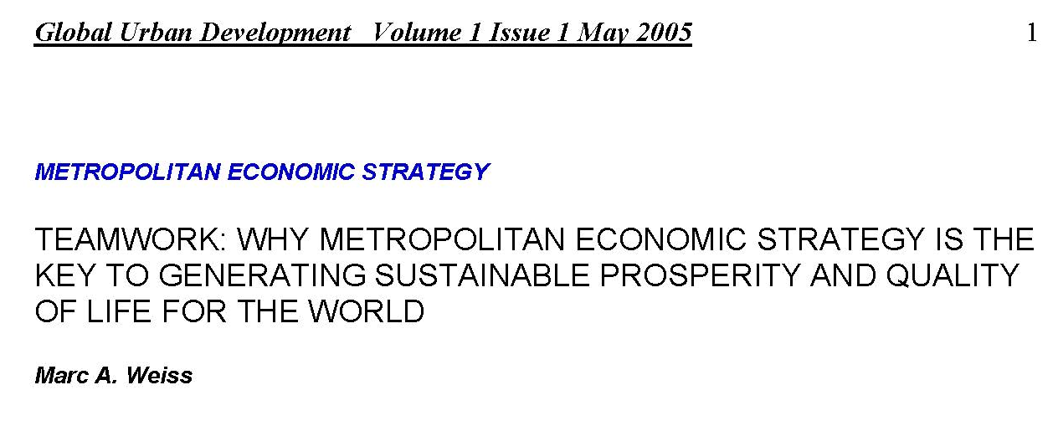
GLOBAL URBAN DEVELOPMENT

Slide 37
METROPOLITAN ECONOMIC STRATEGY TWO TYPES OF MOTIVATION
GLOBAL URBAN DEVELOPMENT
Crisis: Barcelona, Singapore
Opportunity: Shanghai, Austin

Slide 38
KEY LESSONS FOR ECONOMIC DEVELOPMENT
GLOBAL URBAN DEVELOPMENT
LESSON 1: THINK AND ACT STRATEGICALLY
LESSON 2: CREATE COMMON IDENTITY AND SENSE OF PURPOSE
LESSON 3: INVOLVE EVERYONE
LESSON 4: TAKE ACTION AND PRODUCE RESULTS
LESSON 5: BUILD ON THE FUNDAMENTALS
LESSON 6: FOCUS ON THE BIG RESOURCES
LESSON 7: BE YOURSELF
LESSON 8: COLLABORATE WITH AND SUPPORT THE PRIVATE SECTOR
LESSON 9: BE COMPREHENSIVE – LINK GROWTH OF BUSINESSES, JOBS, AND INCOMES TO PEOPLE AND PLACES
LESSON 10: CONNECT TO THE DYNAMICS OF THE REGIONAL ECONOMY
LESSON 11: WORK WITH AND STRENGTHEN CIVIL SOCIETY
LESSON 12: IMPROVE QUALITY OF LIFE – SUSTAINABILITY AND INCLUSIVENESS

Slide 39
GLOBAL URBAN DEVELOPMENT
For more information,
please visit the GUD website:
www.globalurban.org
email me at:
marcweiss@globalurban.org

